Slide 1
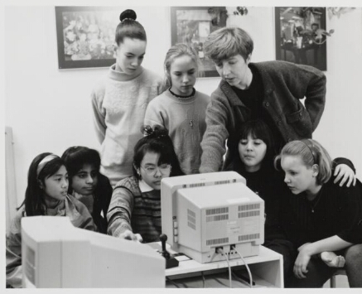
Gender-based hate speech and cyber violence – State of Play and recommended actions
Paula Thijs
Javier Koole
INACH Annual conference 2022

Slide 2
Paula Thijs senior researcher Javier Koole researcher & policy advisor

Slide 3
Atria
Sharing the past, debating the present and creating the future

Slide 4
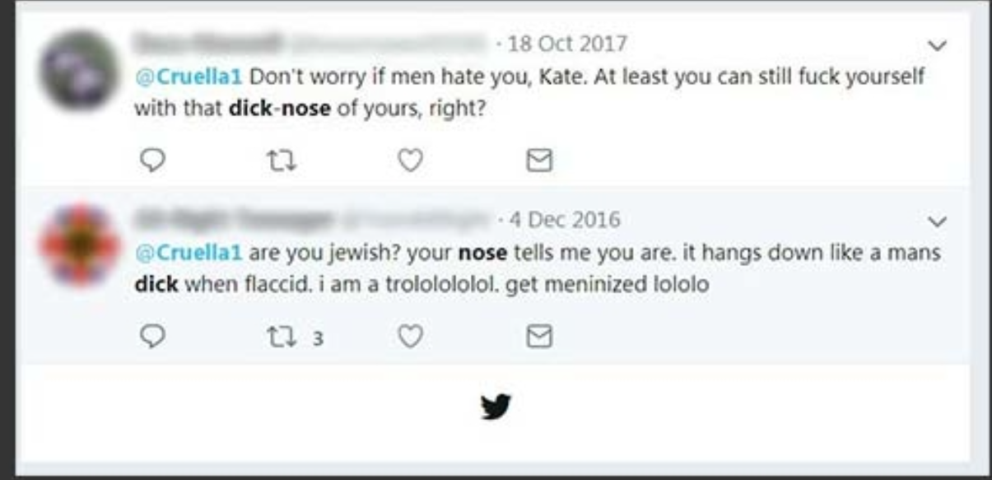
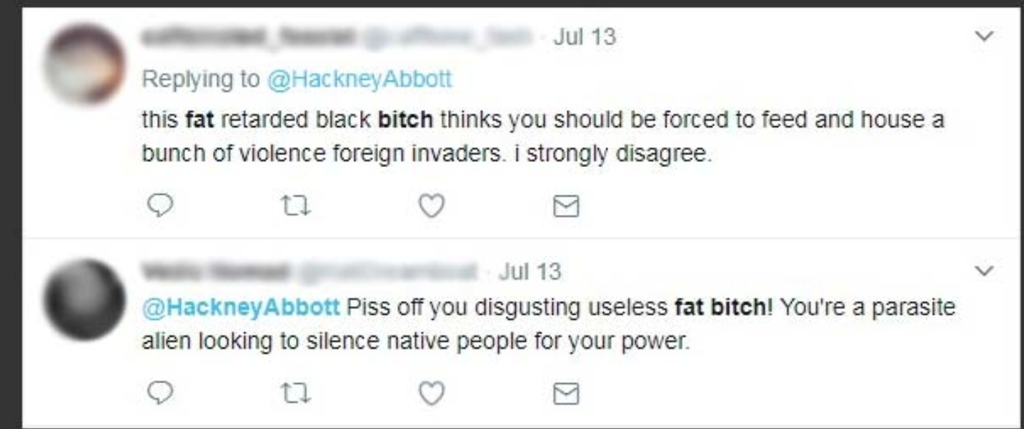
Trigger warning the following pictures depict violent language against women
Notes:
Groeneamsterdammer 2021
https://www.amnesty.org/en/latest/news/2018/03/online-violence-against-women-chapter-3-2/
Give context of the three women:
Jessica Valenti: is a US journalist that has faced online gender-based violence
Abbott: is a House minister of the UK
UK political comedian Kate Smurthwaite
Ask the participants what they see. Do they regard this a form of violence and why?
Make connection with the fact that not only women in politics are confronted with online hate--> such are other forms like sexual harrasment such as exposing, revenge porn, online stalking. To understand the gender dimension to these forms of violence we first to discuss 3 key norms.

Slide 5
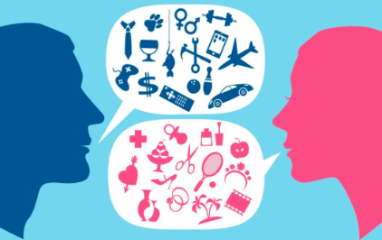
Sex, gender & gender stereotypes
Sex: physical traits of people
Gender: how people feel and present themselves
Gender stereotypes: ideas and expectations of how women and men should behave in society ​
Notes:
3 min Sekse: noemen we ook wel geslacht en gaat over de lichamelijke kenmerken van mensen. Dus het lichaam, geslachtsdelen of hormonen die we maatschappelijk toeschrijven aan mannen of vrouwen. ​
-Maar wat houdt Gender in? Gender: verwijst naar sociaal of culturele rollen in een bepaalde maatschappelijke context. Het gaat vooral om hoe mensen zichzelf presenteren en zien en hoe ze uiting geven van hun man of vrouw zijn, dit kan je bijvoorbeeld zien aan gedrag. Bij gender gaat het dus om mannelijkheid en vrouwelijkheid als een maatschappelijk fenomeen waarbij gender betekenis geeft wat mannelijkheid of vrouwelijkheid is​
​
Ten eerste heb je cisgender dat houdt in dat je genderidentiteit dus hoe je voelt overeenkomst met je sekse die je bij je geboorte is toegewezen. Dus je voelt je man en je sekse is man. ​
Transgender of transpersonen zijn mensen waarbij het genderidentiteit niet overeenkomt met hun sekse die is toegewezen bij hun geboorte. Bijvoorbeeld iemands genderidentiteit is vrouw, maar haar sekse man bij geboorte (jurdisch) is toegewezen als man. ​
Er zijn ook mensen die zich niet als man of vrouw of net zo zeer man of vrouw voelt, identificeren zich als non-binair​
​
Kortom, genderstereotyperingen zijn gendernormen die bepalen wat mensen in een bepaalde gender behoren te doen en wat we verstaan onder vrouwelijkheid en mannelijkheid en zijn vaak negatief en versterken genderongelijkheid. Deze worden van kinds af aan met de paplepel ingegoten zo wordt het bijvoorbeeld verwacht dat meisjes met poppen speelt en jongens met bijvoorbeeld auto’s of met technische dingen spelen. ​

Slide 6
What is gender-based cyber violence?
No universal typology or definition yet
Many terms do not cover the full range of behaviour
nor the gendered patterns in cyber violence
“Online and ICT facilitated violence against women and girls” (UN Women)
“An act of gender-based violence that is perpetrated through electronic communication and the internet” (EIGE)
Notes:
To date, there is no universal typology/definition of behaviours or action that is considered to group together all forms of violence against women perpetrated online or through technology. Many terms currently in use do not cover the full range of behaviour (e.g. sexual violence, not online online aspects but also technology-facilitated abuse), and general definitions of cyber violence and cyber hate are often gender neutral and do not highlight the gender pattern in the abuse (e.g. intimate partner violence perpetrated through digital means, violence perpetrated through technology yet to be developed)
Lack of awareness of the gendered nature of cyber violence in policies and interventions to combat cyber violence, as well as a lack of awareness of the digital dimensions of gender-based violence in the fight against GBV.
Some definitions of cyber violence against women and girls:
EIGE: Gender-based violence that is perpetrated through electronic communication and the internet.
GREVIO: Violence against women in its digital dimension
Cyber violence against women and girls, cyber stalking, cyber harassment, gender-based hate speech etc.

Slide 7
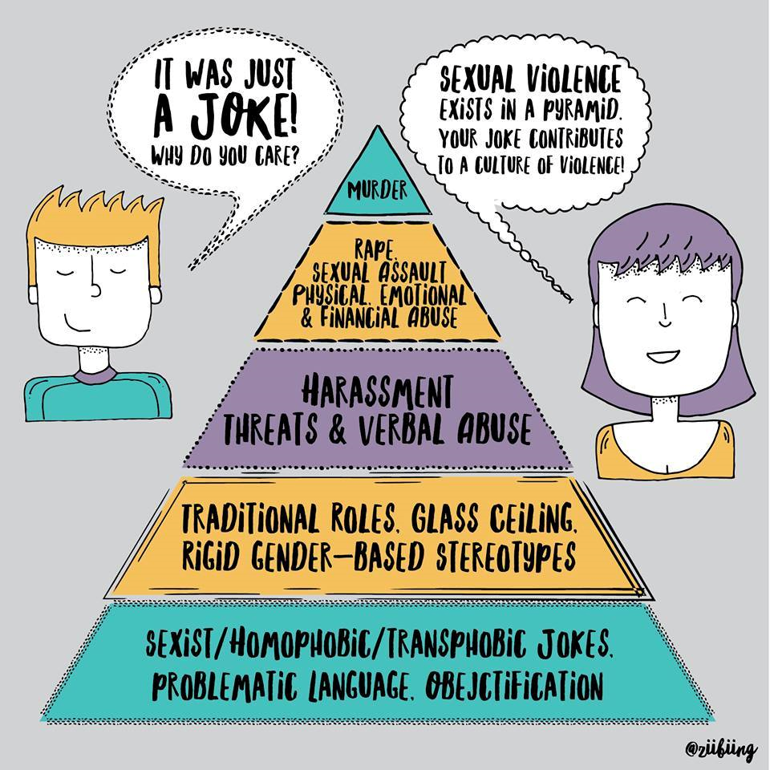
How is cyber violence gendered?
Women and girls, and LGBTIQ+ people more at risk
Deeply rooted in existing power dynamics
Digital gender gaps
Notes:
So, how is cyber violence gendered, and why is it important to take a gendered perspective on online hate speech and cyber violence?
Women and girls, and LGBTIQ+ people more at risk to experience cyber violence and to suffer from its impact. Especially young women, women challenging traditional gender stereotypes and women with intersectional identities who may be more exposed to discrimination of violence because of their sexual identity race, colour, language, national or social origin, disability etc. Studies show that cyber violence is stronger against lesbian, bisexual and transgender women, as well as women from ethnic or religious minorities.
Women are often attacked because of their capacities and qualities as women. There are many forms of cyber violence that target women and girls almost exclusively.
Cyber violence against women and girls (in all their diversity) is deeply rooted in existing and persisting power dynamics, attitudes and inequalities between men and women in societies, including mysoginy. Victim blaming, feelings of shame and guilt
Also related to other gender gaps in the digital sphere, such as gaps in digital literaracy, women’s online representation and participation, and gender segregation in STEM/ICT. Both as a cause and a consequence 🡪 vicious cycle
Hence, it is yet another form of abuse and silencing of those who deviate from the dominant gender norms, embedded in existing gendered power structures.
Therefore, ignoring the wider gender pattern associated with cyberviolence risks missing the social reality of violence against women stemming from the idea of the inferiority of women or from stereotyped roles for women and men.

Slide 8
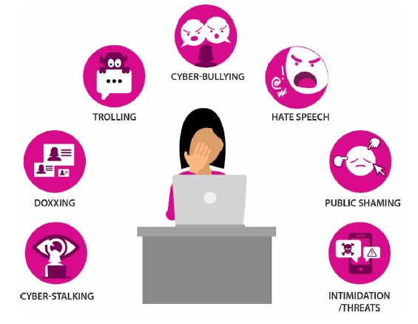
Notes:
Source: UNESCO via Wikipedia
https://en.wikipedia.org/wiki/Online_gender-based_violence
Main features: similarities with offline violence, but also some specific features that make it a very complex and challenging issue
Many different and evolving forms. Online extentions of violence in the offline world, but also different and unique forms of violence such as non-consensual sharing of intimate images or doxing. From person-to-person or public
- Different types of perpetrators: “the usual suspects” of gender-based violence in the physical world, such as intimate partners or ex-partners, relatives, but also anonymous and/or unacquainted perpetrators in the cyberspace
Across platforms, technologies and cyberspaces, e.g. social media platforms, messaging apps and discussion sites. Digital space is constantly involving, new manifestations of online violence. Metaverse as new cyberspace for virtual rape and other forms of GBCV. but also other ICT tools, such as IoT, spyware, discrimination through algorithms and AI.
Global phenomenon: across borders, cultures.
Overlap online and offline GBV, not mutually exclusive. Online hate and violence may spill over into offline forms of violence (e.g. stalking); digital experiences may be an extension of experiences of violence in the physical sphere; offline violence can be facilitated and amplified by online abuse, e.g. doxing may lead to discrimination in the workplace, abusive partners use the digital sphere to trap women in their abusive relations, eg by threatening to spread sexual images
(Sexist) hate speech one of many acts of gender-based cyber violence

Slide 9
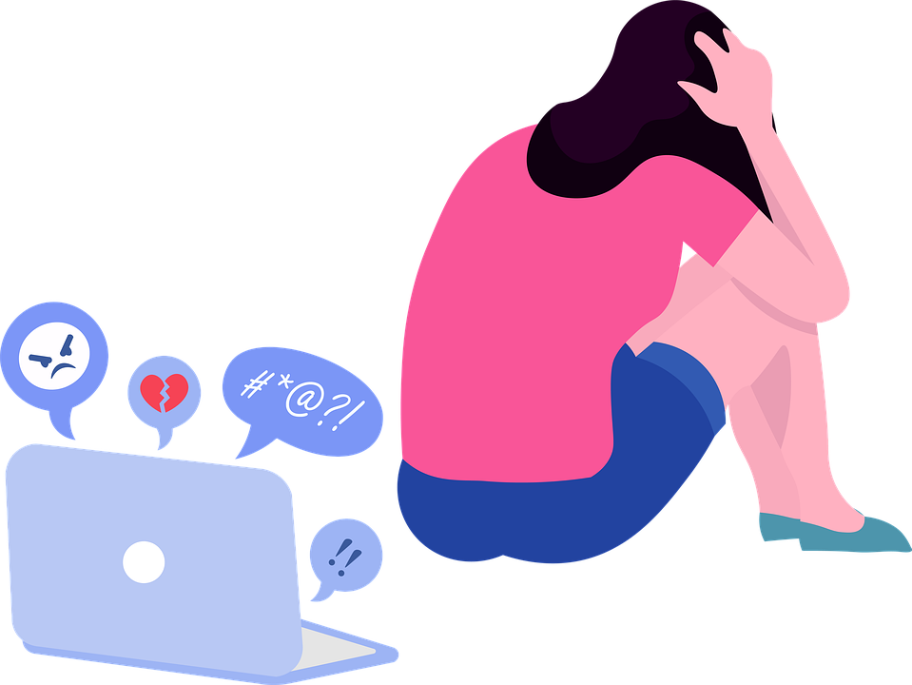
Prevalence of online gender-based cyber violence
FRA, 2014:
5% of women in the EU have experienced one or more forms of cyberstalking since the age of 15
11% of EU women has experienced cyberharassment, in NL: 17%
1 in 5 young women (18-29) experienced sexual cyberharassment, in NL: 1 in 3
3 in 4 women in the EU who experienced online sexual abuse also experienced intimate partner violence offline
Amnesty international, 2018:
25% women in 8 countries received threats on Twitter
Notes:
Both men and women may experience cyber violence, yet women are considerably more likely to experience repeated and severe forms of cyber violence, including sexual violence. Gender-based cyber violence is especially pronounced for women and girls facing intersecting forms of discrimination, based on e.g. sexual orientation, social origin, migration status, disability.
Human rights defenders, journalists, politicians, academics, etc
Some figures:
5% of women in the EU have experienced one or more forms of cyberstalking since the age of 15. Among young women (18-29): 4% experienced cyber stalking in the past 12 months (vs 2% in total pop)
11% of EU women has experienced cyberharassment, in NL: 17% (4th in EU, after Denmark, Sweden and Slovakia)
1 in 5 young women (18-29) experienced sexual cyberharassment (vs 11% women in general EU population), in NL: 1 in 3
Note that Netherlands has a high rate of internet access
25% of respondents polled across eight countries had received threats, including of sexual
violence, physical pain, incitement to suicide and death towards them and their
family on Twitter
Yet, these are snapshots, research is fragmented and up-to-date comparable data is lacking. FRA and EIGE are conducting a study in the EU

Slide 10
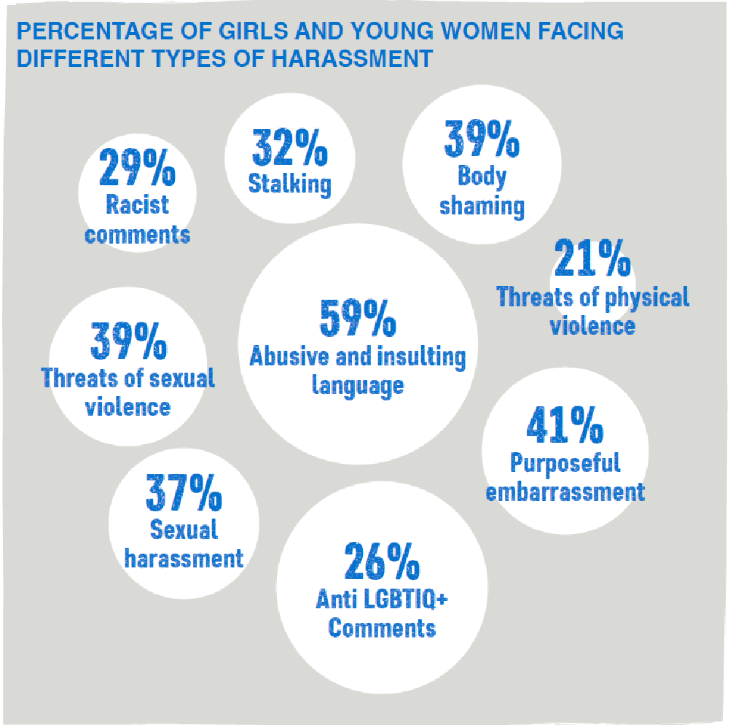
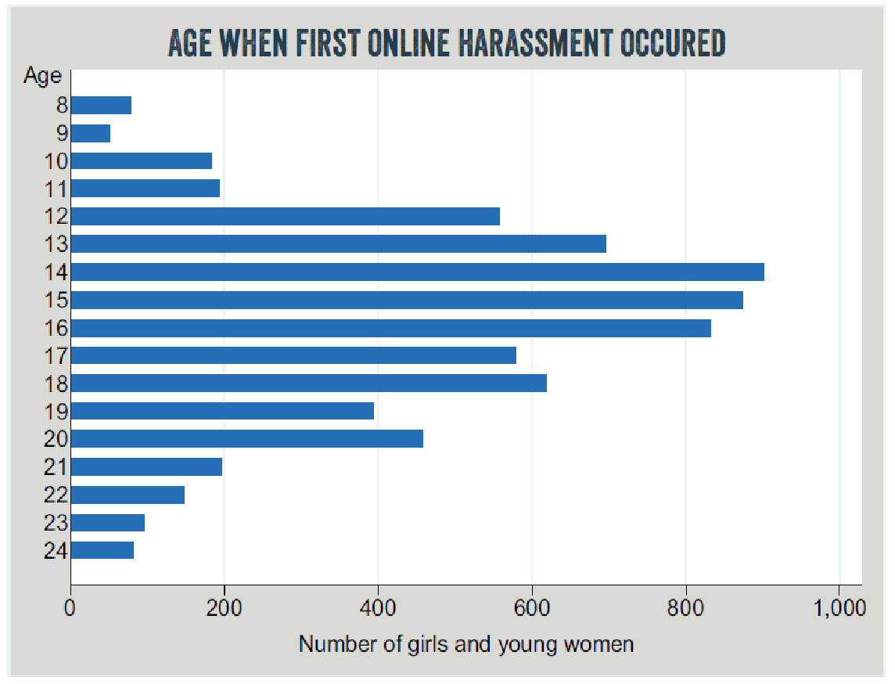
Plan International, 2020:
Notes:
More than half of 15- to 25-year old women from 22 countries reported experiences with online harassment on social media platforms

Slide 11
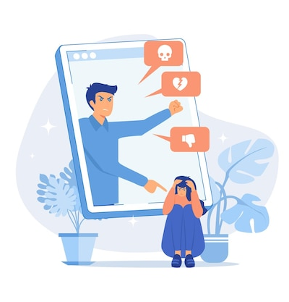
Perpetrators of gender-based cyber violence
Research is scarce
Majority of perpetrators is male
Strangers / intimate partners?
Role of bystanders: victim blaming
Notes:
Plan International 2020:
76 per cent of respondents thought their harasser was probably male
29 per cent probably female
Mostly strangers or anonymous social media users
11% current or former intimate partner
Nordic Digital Rights and Equality Foundation ongoing research into online abuse in Nordic countries:
- 76,5% of victims is female
- 92,9% of perpetrators was male
- Large majority of perpetrators between 18-30 years old
71% romantic partner, ‘only’ 14% stranger
Victim blaming mostly in sexual cyberharrashment. So from peers, teachers, and youth professionals, they usually assume that victim is to blame. For example through the questions they ask e.g. why did you send these pictures, you know you should not be doing that.

Slide 12
Impact of gender-based cyber violence
Severe impact on:
psychological and physical health, livelihoods, physical safety and reputation
Lower self-esteem, loss of confidence: 42% young women
Mental or emotional stress: 42% young women
Feeling/being physically unsafe: 24% (Plan International, 2020)
women’s participatory rights: silencing and self-censorship
3 in 4 women changed use of online platforms
1 in 3 stopped posting content expressing opinions (Amnesty International, 2017)
Notes:
- Serious impact on womens and girls lives, including psychological and physical health, their livelihoods, their physical safety and their reputation (GREVIO, 2021)
E.g. lower self-esteem, mental stress, but also issues with family and friends, problems at school
- Severe implications for women’s participatory rights online. Women are silenced and censor themselves, which makes women’s voices less heard
Spill over effects
Witnessing online cyber violence and hate speech affects other women, especially young girls, it reduces their self-confidence online, results in withdrawal online, and hampers young women’s political ambitions
Online abuse and violence may spill over into offline forms of violence (e.g. stalking)
Offline violence against women and girls is facilitated and amplified by online abuse, e.g. doxing may lead to discrimination in the workplace, abusive partners use the digital sphere to trap women in their abusive relations, eg by threatening to spread sexual images

Slide 13
Threat to equal representation and democracy
Cyberviolence hampers (young) women’s political ambitions
“I try to avoid online discussions and I reply very little to messages. […] Yeah also to avoid online hate speech”
“But yes, these are moments of: yes what am I doing this for? What if I bring my family in danger? Is this all worth it?”
Notes:
Study that analysed 339.932 tweets to Dutch women running for parliament, before the parliamentary elections in March found that at least 10% of tweets contained hate or threats, majority was sexist
Interviews by Atria with local politicians showed that they got hampered in their political ambitions, some indicated to think about quitting, others changed their online behaviour and avoid public discussions online (which has a negative impact on their visibility and political career). Worries about the safety of their families, or see that their relatives also suffer from the hate they receive online
One of the women mentioned a tweets of her went viral. She reveiced a lot of aggressive threats. It was also picked up by websites and even by Dutch television, so it got worse and worse.

Slide 14
What does Atria do to combat gender-based cyber violence?
We focus on the root causes, thus tackling rigid gender norms:
Create gender sensitive or gender transformative interventions
E.g. “Lefgozers” intervention
Focus on Schools & youth care institutions
Educate youth professionals
E.g. we developed a workshop “g-woord”
Focus on perpetrators
Notes:
We focus on the underlying norms that causes gender based online violence. Therefore, we focus on preventing online gender based violence and we focus on the youth. We try tacke rigid gender norms they seems to jusitify and reproduce the gender based violence that happens online. Therefore, to break those norms we hope to prevent that the youth thinks it is oké to do any form online gender based violence and to prevent the violence from happening.
To do that, we create gender sensitive or gender transformative interventions. These interventations have as principle to address rigid gender norms. For example, the intervention Lefgozers is a tool/ freely translated Boys with guts is an intervention that engages with male teens to talk about masculinity and support them to engage in positive masculinity practices instead of negative one. Because we see that when we tackle masculinity (such as toxic masculinity) it also aids in the prevention of gender based violence.
We also focus on school & youth professionals:
So we educate youth professionals with different factsheets, tools, e-learnings and workshop such as the G-word. In this workshop youth professionals learn what the relation is between gender and violence and how they can use that knowledge to prevent gender based violence from happening. We specifically focus on online gender baed violence, such as shame sexting
Also we try to shift the narrative that focusses on perpetrators instead of victims. To deal with the root causes we need to focus on changing or preventing the youth from becoming a perpetrator. So yes victims need support, but perptrators need punishment but help as well so that are not reproducing violence.
and focusses on the perpetrators of GBV-online instead of only the victims:
instead of victims (prevent victim blaming)

Slide 16
Thanks for your attention

