Slide 1
INACH’s 2020 Annual Conference on antisemitism
14th October 2020
The use of law to combat antisemitism and Holocaust denial
Karoline Fernandez de la Hoz, director of OBERAXE,
Director of the Spanish monitoring centre for racism and xenophobia (OBERAXE)
Secretary of State of Migrations
Ministry of Inclusion, Social Security and Migrations
Notes:
Good afternoon, pleasure to participate in this conference
Thanks to INACH and to McI for the invitation
Title, combat antisemitism and Holocaust,
talk on how we implement the law in our work according tour mandate

Slide 2
The Spanish Observatory on Racism and Xenophobia (OBERAXE)
RD 497/2020, of 28th April, which develops the organic structure of the Ministry of Inclusion, Social Security and Migrations
Gathering and analysis of information on racism, Xenophobia In order
to understand the situation and its evolution
Promotion of the principle of equal treatment and non discrimination
and combating racism and xenophobia
Collaboration and coordination with public and private partners, at national
and international level involved in the prevention and fight against racism
and xenophobia
Elaboration of plans, studies and strategies to foster inclusion of migrants,
and the evaluation of those.
Notes:
OBERAXE, was established in 2006, and is one of the national institutions participating in the prevention and fight against intolerance.
Specifically linked to migration which is the largest group of the population potentially discriminated.
Prevention of racism and xenophobia was incorporated to the design of national migration policies since the beginning.
Under, article 71 of organic Act 4/2000 of rights and liberties of the foreign population in Spain.
As our identity as human beings is multifaceted, we work to combat different intolerance, mainly to protect human dignity.

Slide 3
Spanish Penal Code hate crime and hate speech: antisemitism specifically mentioned
Art 510
Promote hate incitement and hostility towards persons or groups due to racism, antisemitism, or other motivations related to ideology, religion, beliefs, ethnic, racial or national origin, gender orientation or identity, disease, disability.
Spreading material which promotes hate or violence, what is called “hate speech”, as defined by Council of Ministers of the European Council.
Public denial or exaltation of crimes committed against groups or persons, due to their religion, ethnic group, gender identity, disease….
Humiliation, contempt, discredit of person or groups in the previous paragraphs.
Art. 22.4
“Aggravating circumstances… Committing the offence for racist or anti-Semitic reasons, or another kind of discrimination related to ideology, religion or belief of the victim, ethnicity, race or nation to which he belongs, his sex, sexual orientation or gender identity, gender role bias, illness suffered or disability”
Notes:
Regarding antisemitism we have the tools
Hate to others identity is punished
committed through social networks, penalties will be higher and contents should be withdraw
Equality law, to fight discrimination in a less severe scale than the penal code

Slide 4
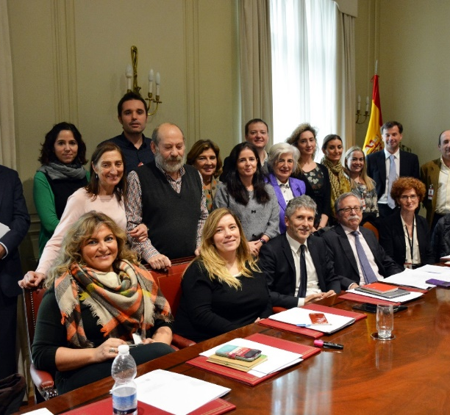
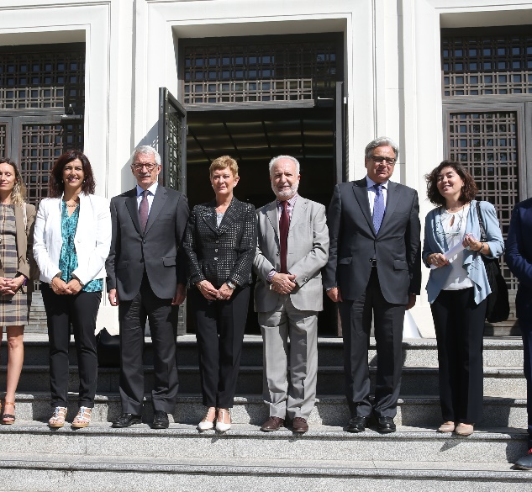
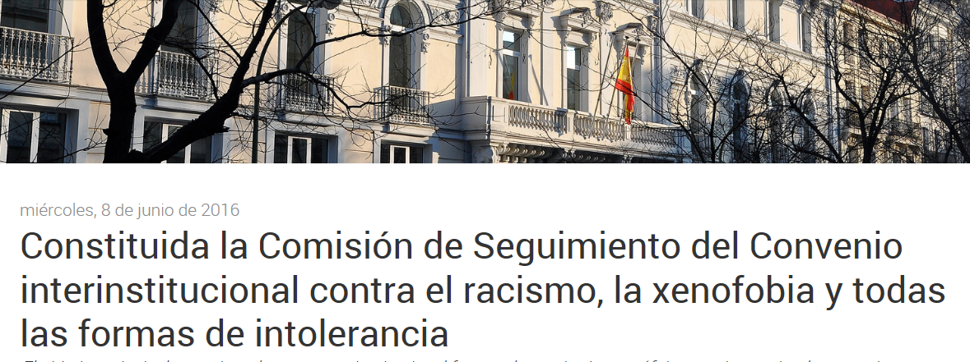
MoU for the Interinstitutional coordination and cooperation against racismo, xenophobia and other intolerance
2015
2018
Notes:
Preventing and fighting hate crime, is the task of several Institutions and CSOs working in different areas from; prevention, raising awareness, penal prosecution, collecting and analysing information, on hate crime but also on racism, xenophobia and other intolerance in general and protecting victims.
In summary the final objective is to protect and respect human dignity
Collaboration on collection of data, statistics, and analysis
Organization and joint execution of training and awareness activities
Cooperation on academic research and publications
Exchange of publications, information, mutual advice,
help and support
Umbrella national strategy on racismo and xenophobia
CGPJ, Fiscalía General del Estado, Ministerios de Justicia, de Interior, Educación y Formación profesional; Trabajo, Migraciones y Seguridad Social; Presidencia, Relaciones con las Cortes e Igualdad y de Cultura y Deporte.
Participan plataformas de la sociedad civil.
Firmado en 2015 y renovado en septiembre de 2018.
Basado en la Estrategia Integral

Slide 5
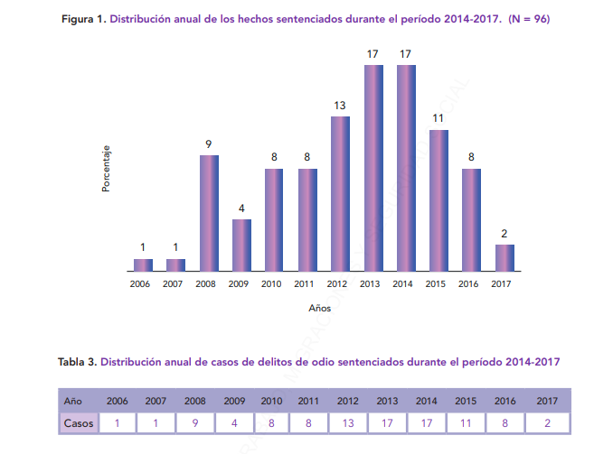
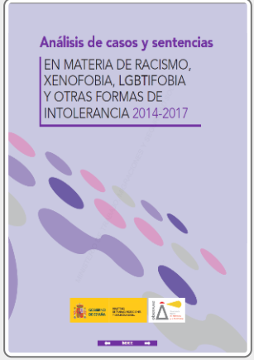
Analysis of hate crime resolutions & statistics Working group
Analysis of judicial resolutions 2014-2017
Traceability of hate crime from report to police to the final judicial resolution
Subgroup to implement practical improvements

Slide 6
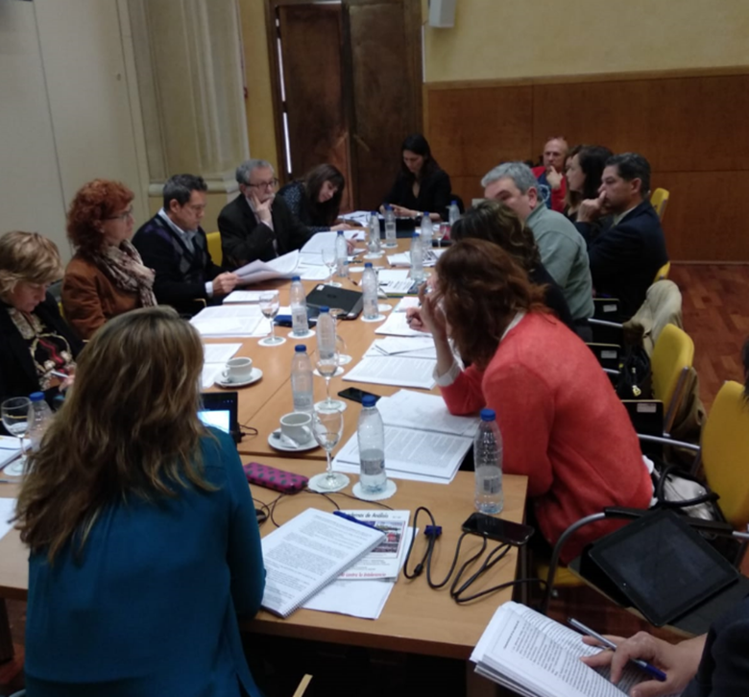
Traceability of hate crime: from reporting to police, to the judicial resolution
High number of incidents reported to the police (1.598) in 2018 versus small number of resolutions (200 cases) (2014-2017)
Available data bases only included cases of multi-personal tribunals (meaning penalties over 5 years)
Not single registration number along the whole process
Administrative and penal procedures mixed
Different IT applications in different regions and institutions, not compatible between them
No specific fields to identify hate crime
Some cases not reported to the police, or to the prosecutor
Notes:
High number of incidents reported to the police (1.598) versus small number of resolutions around 200. (2014-2017)
Available data bases only included cases of multi-personal tribunals (meaning penalties over 5 years)
Not single registration number along the whole process
Administrative and penal procedures mixed
Different IT applications in different regions and institutions, not compatible between them
Not variables on hate crime

Slide 7
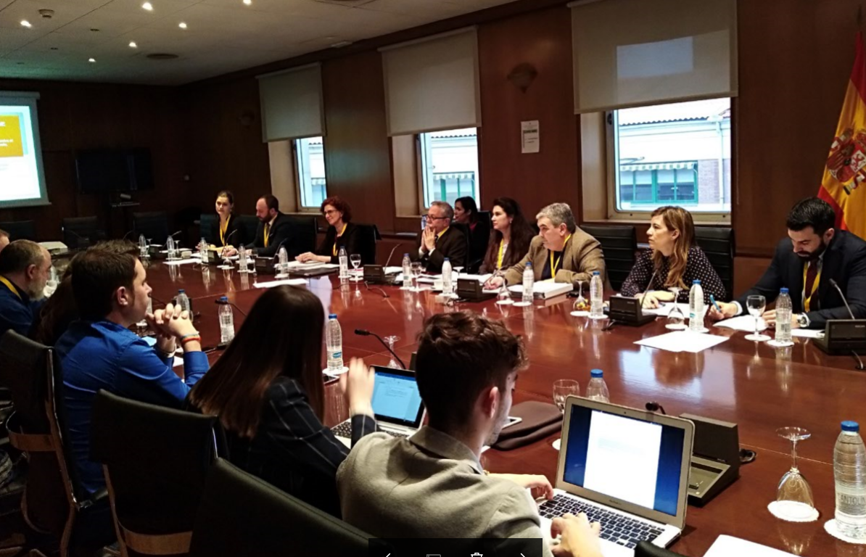
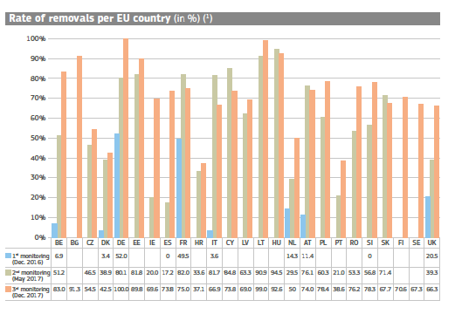
Hate speech Working group
http://www.inclusion.gob.es/oberaxe/ficheros/documentos/Informe_Delitos_Odio_Final.pdf
Notes:
Report on definitions, what do we talk about when we refer to discrimination, hate crime, hate speech, etc.
Workshop to describe the situation of institutions, CSOs/ NGOs and internet social platforms on hate speech online
Participation in the monitoring of the Code of Conduct of the EU Commission (Oberaxe, National Office against Hate Crime (Interior Ministry) Movimiento contra la intolerancia, FSG, FELGTB)
EU recommendation 2018/334. to adapt it to the Spanish situation. Developing proposals to work in a coordinated way

Slide 8
Protocol to combat illegal hate speech online
European Commission's EU Recommendation 2018/334, of 1 March 2018, on measures to effectively combat illegal content.
Definition of illegal hate speech and illegal content
be a tool for cooperation and coordination between Spanish state authorities, civil society organisations and Internet data hosting service providers.
Contact Point for the competent authorities.
Commission for the Accreditation of trusted flaggers (selection and training).
Governance mechanisms.
Notes:
We choosed the collaboration way as the EU.
The work developing the protocol helped to understand each other

Slide 9
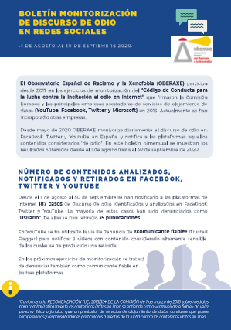
OBERAXE: Monitoring hate speech online
Notes:
Hate speech influenced by the media news
Not much antisemitism but some times linked an others not

Slide 10
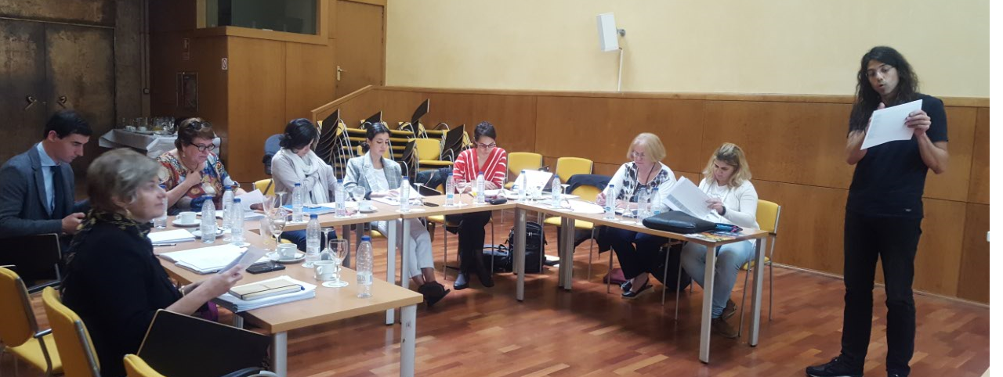
Objective
Contribute to improve capacity
of public authorities and key partners to identify,
analyse and evaluate
racist, xenophobic, islamophobic, antisemitic and anti-roma
hate speech
Notes:
ANTISEMITISM On 26 May 2016, 31 member States of the International Holocaust Remembrance Alliance, IHRA adopted the following definition of antisemitism: “Anti-Semitism is a certain perception of Jews that may be expressed as hatred toward Jews. Rhetorical and physical manifestations of Antisemitism are directed at Jewish or non-Jewish and/or their property, toward Jewish community institutions and religious facilities”.
Brings together governments and experts to strengthen, advance and promote Holocaust education, memory and research worldwide and to uphold the commitments of the 2000 Stockholm Declaration.
The following links provide contemporary examples from daily life, the media, schools, the workplace, and the religious sphere: https://www.holocaustremembrance.com/es/node/196 and https://ep-wgas.eu/docs/pdf/IHRA-Definition-of-Antisemitism-ES-web.pdf

Slide 11
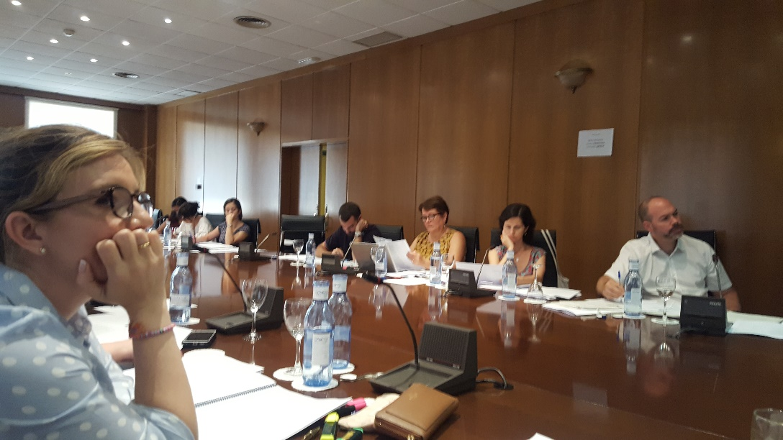
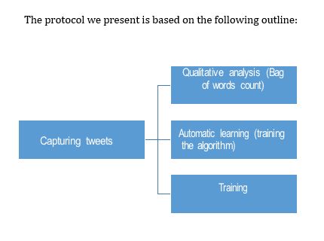
Co-funded by the Rights, Equality and Cirizenship Programme of the European Union.
Indicators to identify hate speech online to evaluate intensity, severity, distribution and impact.
Build an algorithm to systematically collect hate speech in Twitter
Develop shared strategies between public institutions and key partners to fight hate speech online
Disseminate the Project and analyse transferability
Adviser group
http://www.inclusion.gob.es/oberaxe/es/ejes/delitosodio/alreco/index.htm
Notes:
Collaborating with CSO, they are monitoring and evaluating the tool
The tool will be available to use, in exchange of collaboration
Very successful. For a to discuss the shared strategies

Slide 12
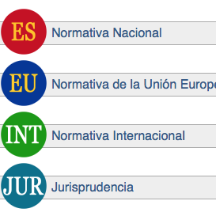
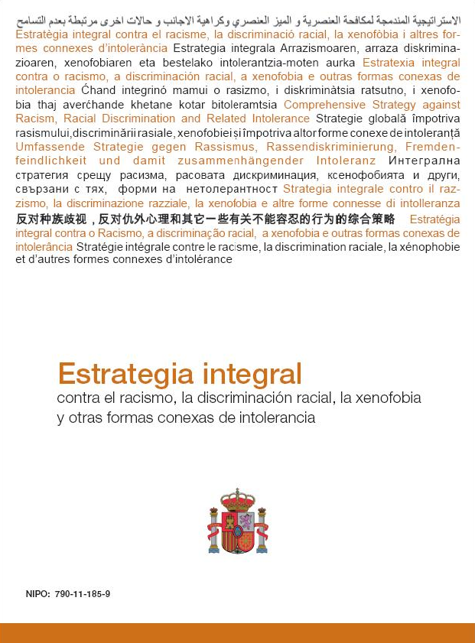
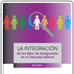
Notes:
Aprobada por el Consejo de Ministros el 4 de noviembre de 2011.
Es una herramienta clave en la lucha contra la erradicación del racismo y la intolerancia y da respuesta a la necesidad de articular y desarrollar las acciones que se vienen desarrollando
Responde al llamamiento de la Conferencia Mundial de Naciones Unidas contra el Racismo, la Discriminación Racial, la Xenofobia y Otras Formas Conexas de Discriminación Racial.
Estrategia:
Aceptada por los distintos gobiernos (política de estado).
Marco de actuación OBERAXE, administraciones, sociedad civil.
Orientación para financiación de fondos europeos
Herramienta exitosa: registro de delitos de odio (formación cuerpos policiales, protocolos), coordinación interinstitucional (persecución jurídico penal), análisis de la situación, actividades en distintos ámbitos educación, cooperación con la sociedad civil, papel relevante en Europa
OBERAXE, papel catalizador valorado así por socios nacionales y europeos

Slide 13
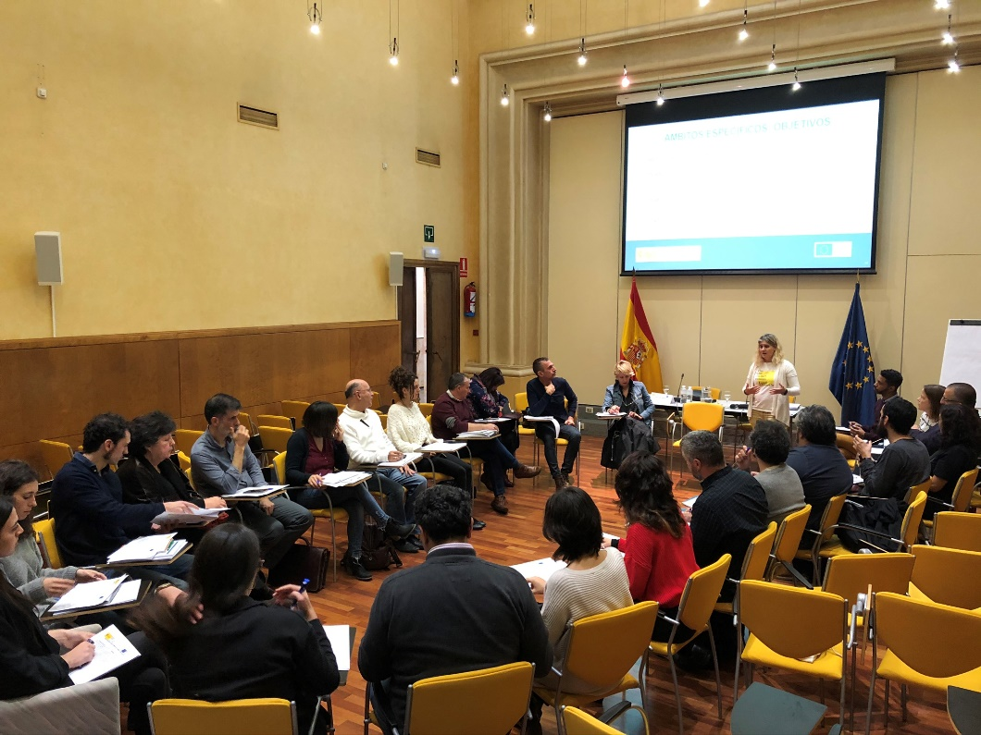
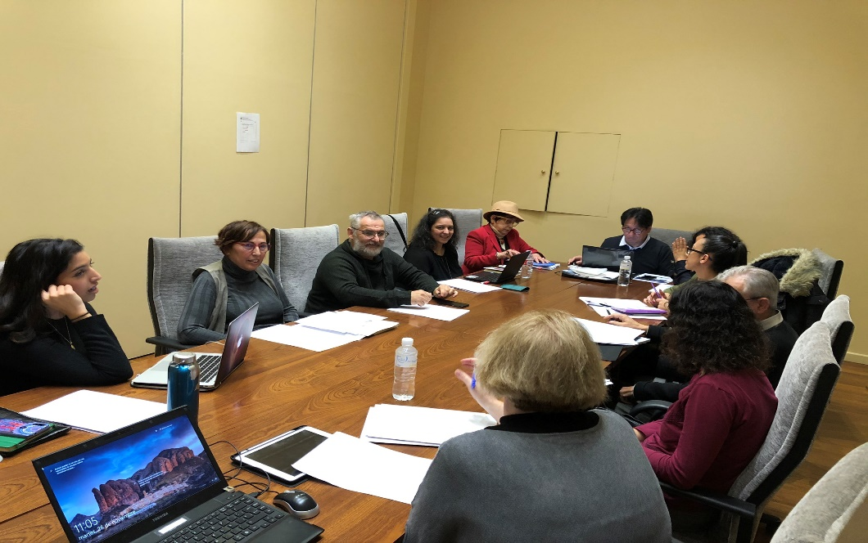
New Strategic frame on inclusion of migrants, racism, xenophobia and related intolerance

Slide 14
Thanks for your attention!
Karoline.fernandezdelahoz@inclusión.gob.es
oberaxe@inclusión.gob.es
http://www.inclusion.gob.es/oberaxe/es/index.htm
Notes:
Antisemitism is independent of the number of Jewish population in the country
Incidents can happen at any time related to specific events or without
Crisis contribute to more intolerance
The conflict between Palestine and Israel contributes to the confusion
We have the tools, our view is broad but taking into account specificities
Your input is welcome

Slide 15
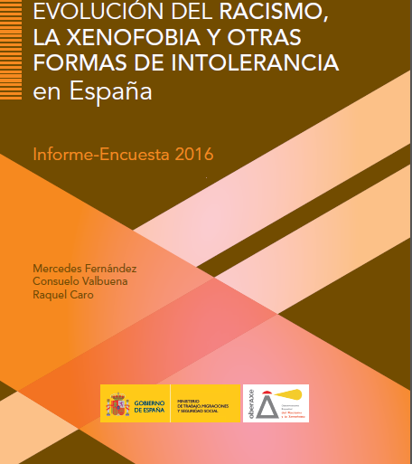
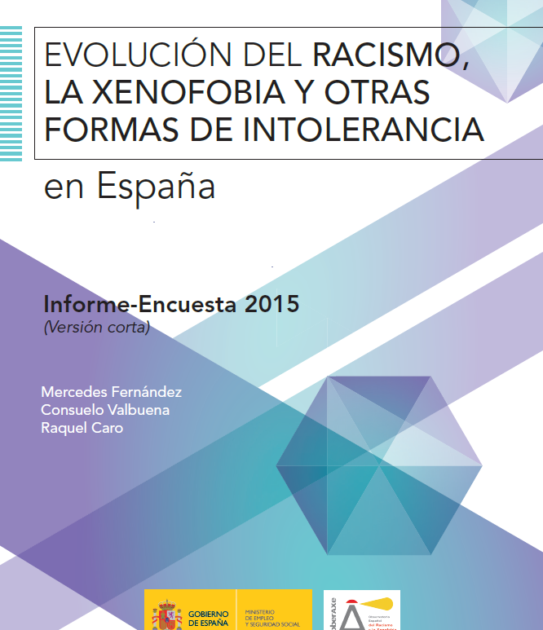
Valoración de la inmigración como positiva o negativa
Encuesta de actitudes de la población Española hacia la inmigración
(CIS, 2008-2017)
POSITIVA
NEGATIVA
9
Notes:
We do a annual survey since 2008 on the attitudes of the Spanish population towards immigrant on a sample of 2500 Spanish citizens older than 18 years. The results are in general good, although the economic crisis had an impact.

