Slide 1
Gender-based hate speech and cyberviolence against women
State of play at the EU level and EWL’s recommendations

Slide 2
Agenda
Introduction of EWL
State of play at EU level
Recommendations
Q&A

Slide 3
European Women’s Lobby (EWL)
Largest Umbrella Organisation of Women’s Civil Society in Europe
31 National Coordinations
17 European-wide member organisations
Representing over 2000 member organisations
Bringing together the women’s movement in Europe to influence the general public and EU institutions in support of women’s rights and equality between women and men
Over 30 years of presence in Europe
Striving to achieve a feminist Europe

Slide 4
EWL’s Work on combating violence against women and girls (VAWG)
EWL Observatory on VAWG
Key issue: Implementation of COM Proposal for a Directive on Violence against women and domestic violence
Ratification and Implementation of Istanbul Convention in all EU Member states and beyond
Specific focus on online VAWG with trainings like #HNHR

Slide 5
State of Play at the EU Level

Slide 6
“any act of gender-based violence against women that is
committed, assisted or aggravated in part or fully by the use of ICT, such as mobile phones and smartphones, the Internet, social media platforms or email,
against a woman because she is a woman, or affects women disproportionately.”
What is gender-based violence against women?
UN Special Rapperteur on Violence against women, it's causes and consequences

Slide 7
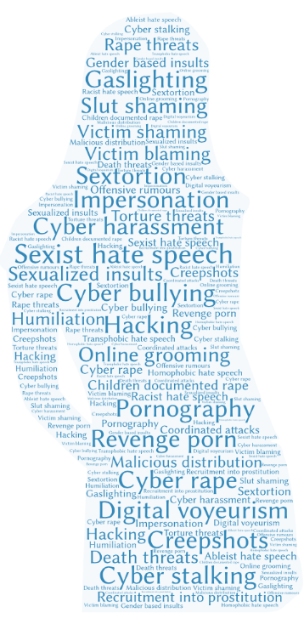
Key findings of #Her Net Her Rights report
Report key findings:
Online Violence Against Women and Girls (VAWG) is a reality: it is a gendered and prevalent phenomenon.
Online Violence Against Women and Girls is part of the continuum of male violence, impacts on all women and perpetuates gender inequality. Affects women in intersections, such as BIPOC women and women with disabilities disproportionatelly.
Understanding the root causes of online VAWG to take action and eradicate it.

Slide 8
Statistics on Cyberviolence against women
The recent 2021 EP study estimates that 4 to 7 % of women in the EU-27 have experienced cyber harassment during the past 12 months, while between 1 and 3 % have experienced cyber stalking.
Violence against women online and facilitated by technology: research/surveys
Plan International: Free to be online? (2020) Highlights the experiences of 14000 girls worldwide:
58% of girls experienced online harassment
50% said they experience more online harassment than street harassment
Amnesty International survey on women's experiences of abuse and harassment on social media (2017):
46% of women responding to the survey who had experienced online abuse or harassment said it was misogynistic or sexist in nature
36% of women in the UK said it made them feel that their physical safety was threatened
European Union Fundamental Rights Survey on Violence against Women (2014):
20% of young women in the European Union had experienced some form of cyber sexual harassment

Slide 9
Recommended Actions
Prevent, Protect & Prosecute

Slide 10
Prevention
Investment in education!
Need for feminist sexuality education, including education on love and equal relationships, in education programmes to challenge harmful and sexist behaviour and sexist and gender stereotypes. Male violence against women starts with boy’s violence against girls and has to be targeted comprehensively in a trauma-, child- and gender-sensitive manner
Awareness of the definition of gender-based cyberviolence
Training for teachers, law enforcements authorities etc.

Slide 11
Protection
Continued and hamonised data collection on cyber violence
Digital literacy especially for women and girls with special attention to safety features on social media platforms
Accountability of platforms - continued improvement of safety features plus legislation on illegal (and harmful) content

Slide 12
Prosecution
Harmonised criminalisation of gender-based cyberviolence
Functioning law enforcement and knowledge on the enforcement of specific laws
Accessibility when it comes to reporting cyberviolence
Awareness of the cross-border implications

Slide 13
Needed EU Legislation
Add VAWG/GBV to the list of Eurocrimes Article 83(1) TFEU
Accept COM Proposal to add hate speech and hate crime to the list of Eurocrimes Article 83(1) TFEU, open door to legislation on e.g. sexist, mysogynist, homophobic hate speech/crime
Improve and implement the COM Proposal for a Directive on violence against women and domestic violence including the provision on cyber stalking, cyber harassment, non-consensual sharing of intimate or manipulated images and cyber incitement to violence or hatred
Seek harmonisation of existing EU legislative instruments, as the Victims’ Rights Directive, the Anti-Trafficking Directive, the Child Sexual Exploitation and Pornography Directive, relevant provisions of the Digital Services Act and any upcoming legislation on hate speech and crime
PLUS: Ratify and implement Istanbul Convention in all EU members states
Notes:
Hamonisation!

Slide 14
Any questions?

Slide 15
Are you aware of any best practices in prevention, protection or prosecution nationally?

Slide 16
How do you see the role of Civil Society when it comes to gender-based cyber violence?

Slide 17
Thank you!
FACEBOOK @EuropeanWomen
INSTAGRAM @EuropeanWomenLobby
TWITTER @EuropeanWomen

