Slide 1
Contre les discours de haine en ligne Africa Sans Haine Presentation
INACH Annual Conference November 4-5, 2021

Slide 2
Theme:
Social media, helping or hindering democracy in Africa ?

Slide 3
In Africa, relations between democracy and social media are still tense.
The behaviors of one and the other are hardly compatible. They live at loggerheads.

Slide 4
Social media in Africa mean excessive freedom of expression, sanctioned by hate speech, fake news, disinformation ...
On the other hand, African democracy is made up of coups, bad elections, constitutional violations and dictatorship.

Slide 5
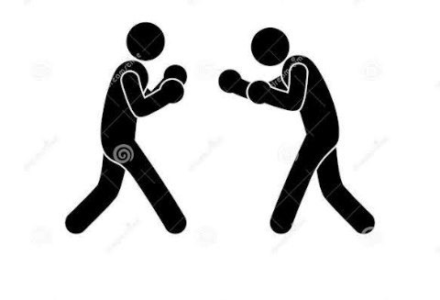
This image shows the tumultuous relationship between social media and democracy in Africa

Slide 6
Here are some figures to understand social media in Africa

Slide 7
According to statistics of October 26, 2021, Africa has a population of 1,387,012,900.
46% of the African population uses the Internet, or 634,863,000 people (statistics March 2021).

Slide 8
Internet users in Africa around the world (statistics for July 2021)
REGIONS | NUMBER OF USERS IN PERCENTAGE
ASIA | 50,3 %
EUROPE | 15,9%
AFRICA | 11,5%
LATIN AMERICA /CARIBBEAN | 10,1%
NORTH AMERICA | 7,6%

Slide 9
African social media users
277,200,000 Africans use social media.
NB: The figures vary slightly according to the sources and the dates of their publication.

Slide 10
Mapping of social media in Africa

Slide 12
Social media in vogue in Africa are:
- Facebook
- YouTube
- WhatsApp
- Linkedin
- Instagram
- Twitter
- Tik-Tok.

Slide 13
Facebook
Facebook is the most used social media in Africa.
It has 206,161,000 subscribers, or 17% of the African population (2018 stats).

Slide 14
In which social media is there a lot of hate speech?
The majority of hate speech in Africa is shared on Facebook.
There is a lot of hate speech on Facebook because it is the social media of ordinary people: ordinary citizens, poor citizens, illiterate people, etc.

Slide 15
On Facebook, there are profiles, groups and pages, some with hundreds of thousands of members.
Almost all of these groups and pages do not have community managers to ensure moderation. Members are sharing whatever they want.

Slide 16
Linkedin
You hardly ever come across hate speech on Linkedin in Africa
This is because Linkedin is a professional network where people publish only on innovations, jobs, companies, startups, opportunities, professional networks ...

Slide 17
Instagram
Hate speech is also lower on Instagram in Africa, except in some videos.
Africans tend to use Instagram as a photo album and not as a social chat network. Their best photos, they post them on Instagram

Slide 18
What age groups are using social media in Africa?
The majority of those who use social media (especially Facebook) in Africa are people aged 25 to 34.

Slide 19
Social media users by age in Africa
AGE GROUPS | PERCENTAGE
25 – 34 ans | 35%
18 - 24 ans | 33%
35 – 44 ans | 13%
45 et plus | 11%

Slide 20
Who publishes hate speech in Africa?
Young people are the biggest propagators of hate speech
Politicians
Community, religious and opinion leaders
Traditional media
You Tube channels
Live Facebook

Slide 21
Which sex shares the most hate speech in Africa?
Men
Women
97 %
3%

Slide 22
What types of hate speech are very common in Africa?
- Incitement to ethnic hatred
Insults
Incitement to murders
Xenophobia
Anti-white or anti-black racism
Animalization
Sexist words
Apology for crimes
Sextapes shared to destroy reputation ...

Slide 23
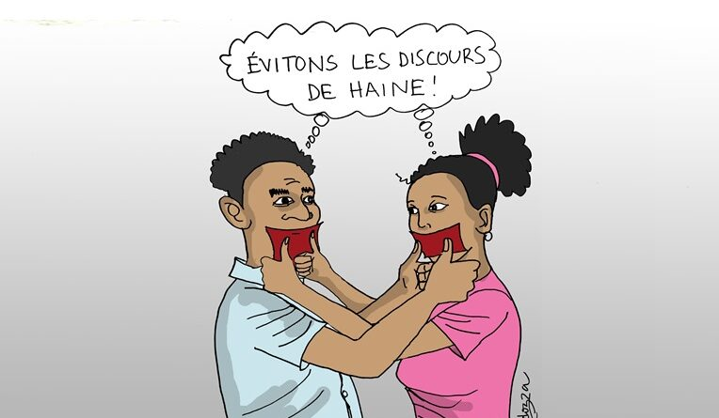
The mouth is also a social media that spreads hatred. We must close it

Slide 24
What are the sources of hate speech in Africa?
Politics, elections, appointments to government, to public institutions, etc.
The supposed superiority of one ethnic group over others or tribalism
Exclusion, marginalization, discrimination
Land disputes between rival ethnic groups.
In fact, a lot of hate speech revolves around politics and ethnic identities.

Slide 25
Anti-Semitism also exists in Africa
In countries like South Africa, it is not uncommon to hear things like, “Down with Israel! "Cases of aggression against Jews as well.
Some Africans of Jewish origin are the subject of hate messages. There are some who are called "brothers of Judas Iscariot", and so on.

Slide 26
Do African women play a role in the dissemination of hatred on social media?

Slide 27
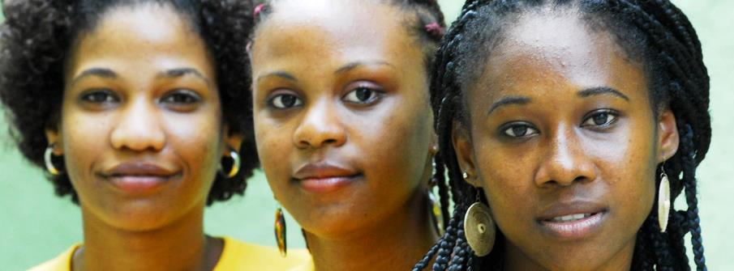
Photo tiers

Slide 28
Generally speaking, African women are very reserved. Rather, it is men who disseminate 97% of hate speech online.
Women just like or comment.

Slide 29
According to our study, the subjects on which African women react quickly on the social media are:
- Women's rights,
Beauty,
Fashion,
Entrepreneurship, romantic relationships, etc.

Slide 30
In the DRC, for example, women are less present on social media than men.
We noticed that, the African woman spreads hatred and fake news less than men.

Slide 31
Estimates of women connected to social media in the DRC
Women 35 %
Men 65 %

Slide 32
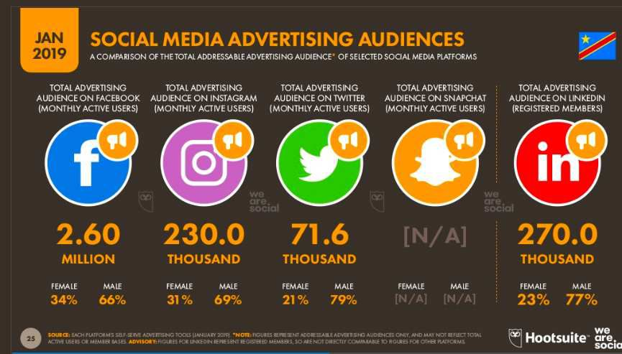

Slide 33
Hate speech from Africans in the diaspora (USA, Europe)
Congolese, Cameroonians, Ivorians, Guineans, Chadians, etc., living in Europe or the United States, make live Facebook every week where they insult and attack ethnic groups and personalities from their countries of origin. Their videos are shared on their YouTube channels very popular in Africa.

Slide 34
These Africans in the diaspora are taking advantage of the strong freedom of expression in Europe to abuse. This is because they know that in the West they are safe from legal action by their countries of origin.

Slide 35
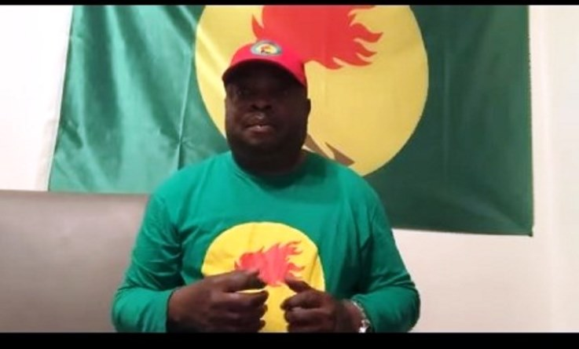
This guy is a Congolese based in Belgium. On You Tube, he insults his compatriots

Slide 36
What NGOs do research on hate speech in Africa?
About research, to our knowledge, to date, only Africa Sans Haine and Internews Côte d'Ivoire do research on hate speech in Africa on an ongoing basis. With monitoring reports every week or every month.
Other NGOs do this, but rarely.

Slide 37
Africa Sans Haine
Côte d’Ivoire

Slide 38
The challenges of fighting hate speech in Africa
1. African states, the media and NGOs do not take the issue of hate speech seriously in Africa;
2. Despite several reports, Facebook, Twitter and other social networks rarely remove reported hate messages. It stays on their platforms for weeks or even months and people keep sharing;

Slide 39
On Facebook, for example, some groups and pages contain only hateful content;
In addition, hate speech outnumber Fake News on Facebook

Slide 41
In several African countries, there are no specific laws against hate speech. That is why it is difficult to repress the authors of such speeches;
The perpetrators of hate speech are sometimes protected because they belong to the party in power, to the ethnic group of such and such authority ... This encourages impunity.

Slide 42
Our needs
- Strengthen the capacities of NGOs in the fight against hate speech;
- Support these NGOs;
- Organize awareness campaigns for young people online and offline
- Etc.

Slide 43
Are social media helping democracy or destroying it in Africa?

Slide 44
For us, the answer to this question is 50-50
Yes, social media are very important to protect democracy in Africa. Almost all of African countries have instituted policies that severely restrict public freedoms, especially freedom of expression.

Slide 45
Peaceful demonstrations are still repressed in Africa. State radios and televisions belong only to officials: president, ministers, MP, etc. Opinions are oriented in the sense of flattering the regime in place.
So, social media are therefore an excellent alternative for Africans to freely express their opinions on the way their countries are managed. They denounce what is wrong and it is very good for democracy.

Slide 46
In contrast, social media undermines democracy because it has become the bastion of fake news, disinformation and hate speech.
They have become a privileged ground for insults, racism, xenophobia, incitement to violence, murders ...

Slide 47
And this is where INACH and its member organizations have their role to play to moralize social media and protect democracy.

Slide 49
Thank you
Jean-Hubert Bondo Africa Sans Haine
Democratic Republic of the Congo

