Slide 1
Holocaust as a figure of speech
Comparative case study
Romania – ActiveWatch
Poland – Never Again Association
Slovakia – DigiQ
Spain – Movimiento contra la Intolerancia

Slide 2
Research framework
Denial
Denying and/or revisionist narratives
Distortion
Trivial, inappropriate and inflammatory comparisons
References:
ADL // Inappropriate Comparisons Trivialize the Holocaust (01/27/2014)
JCPA // Holocaust Trivialization (04/09/2008)

Slide 3
Research framework
2018 – 2020, timeframe
documented media: online media, social media
Social media – public accounts (politicians, influencers, journalists) and regular users’ comments/reactions
Topics: social issues, healthcare, domestic and foreign politics, COVID-19 crisis

Slide 4
Preliminary conclusions
Persistent narratives that are deeply embedded in the popular discourse and perception on Holocaust
Misuse of historical references and symbols, and even of political concepts (doctrines, ideologies)
Incondite arguments (common users)
Abusive appropriation of Holocaust significance and of Jewish trauma
Politically exploited by radical or conservative politicians
COVID-19 pandemic created the perfect storm for the inflammatory narratives that use Holocaust memory/significance as a mean to defy and to oppose “the system” (national or global)

Slide 5
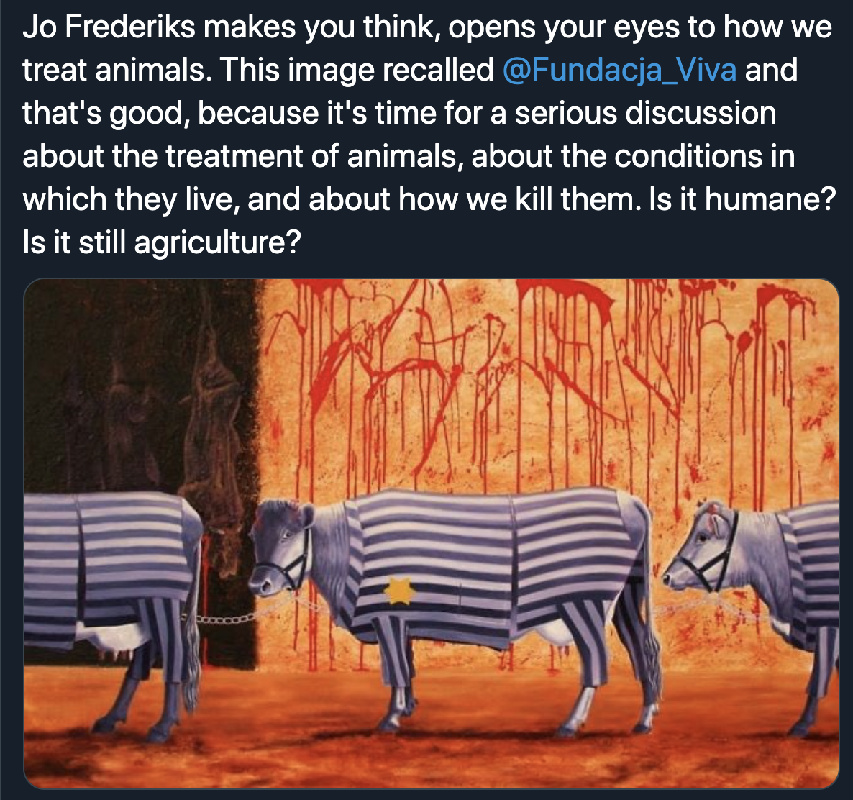
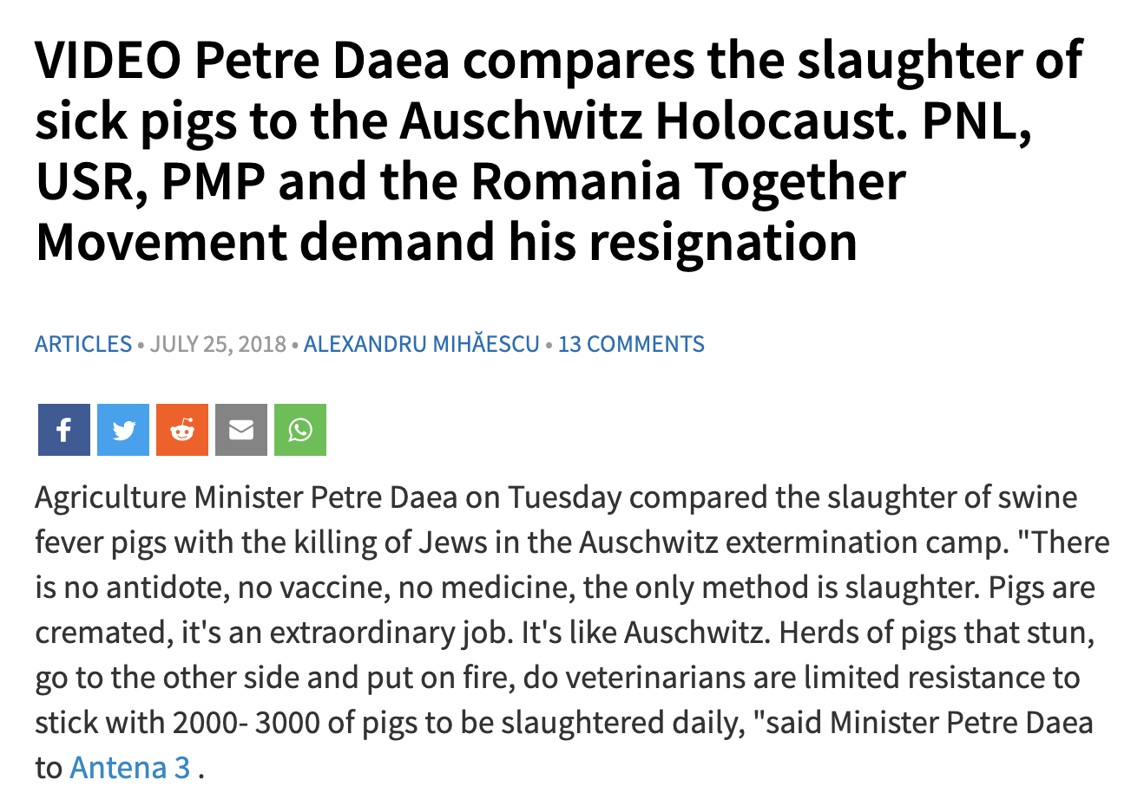
Animal rights, humans’ wrongs
Animal rights activists tend to abusively compare animal conditions to concentration or extermination camps (ES)
In some cases, state officials (RO) or respected politicians (PL) use inappropriate comparisons.

Slide 6
Hospital conditions, a very Romanian problem
Prior to COVID-19 pandemic, narratives comparing Romanian hospitals to extermination camps and medical protocols to “medical experiments” were quite common.
The COVID-19 outburst in Romania simply amplified pre-existent misrepresentations and abusive parallels to Holocaust
Translation: The Romanian healthcare system is a huge national extermination camp.

Slide 7
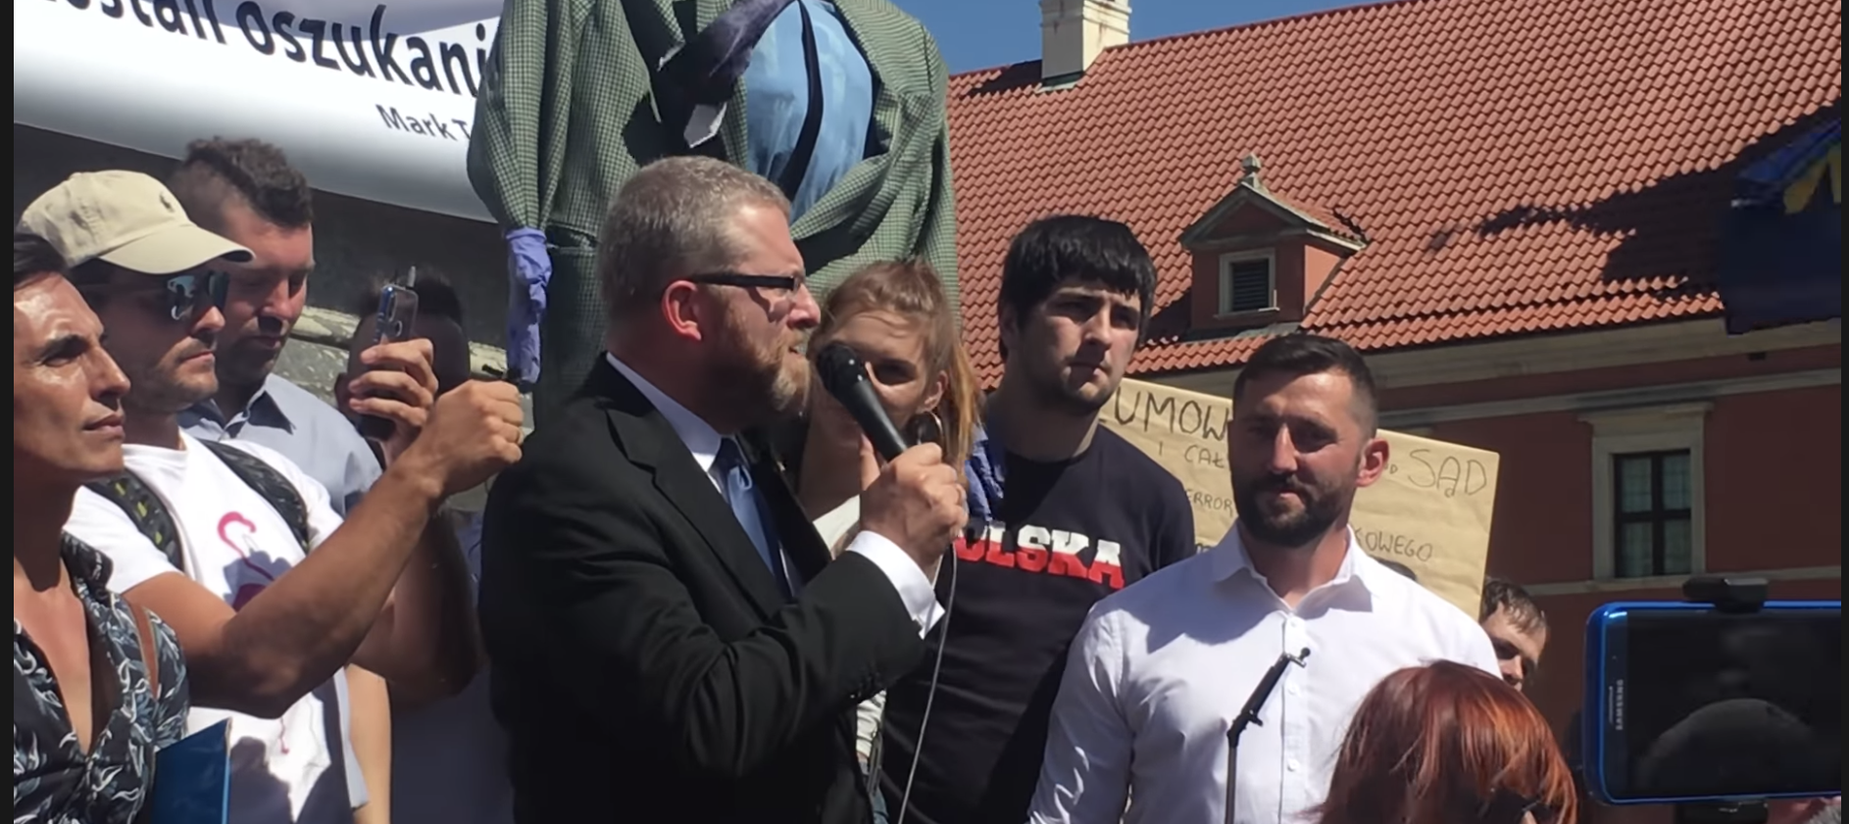
Holocaust trivialization in pandemic context (COVID-19)//Politicians
Radical politicians have exploited COVID-19 crisis for political capital (Poland and Slovakia)
“I will allow myself a drastic analogy. It is like summer 1939. So far they just order some people to wear armbands and when the time will come to go to the ghetto it will be too late for protests. (…) And it is similar today, they order the nation to wear the face masks”. [Grzegorz Braun , member of the Polish Parliament]

Slide 8
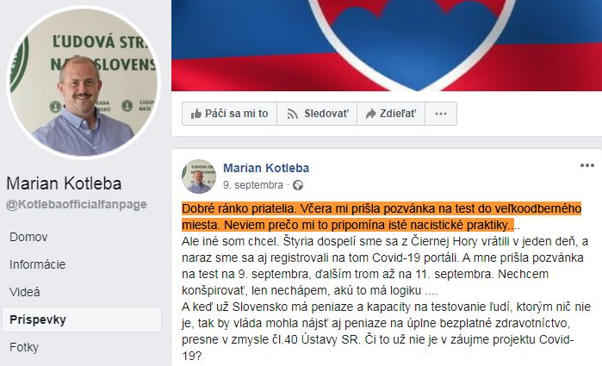
Holocaust trivialization in pandemic context (COVID-19)//Politicians
“Yesterday I received an invitation to testing. I don’t know why it reminds me of Nazi practices” [Marián Kotleba , chairman of ĽSNS extremist party]

Slide 9
Holocaust trivialization in pandemic context (COVID-19)//Politicians
In Romania no politicians openly used explicit comparisons, even though some emerging nationalistic parties endorsed various public protests against COVID-19 restrictions were protesters appealed to semantics and metaphors that could be related to Holocaust
In July 2020, the president of the main opposition party publicly stated that he “would not endorse the transformation of Romania into a medical camp” arguing for protecting human rights and democratic principles

Slide 10
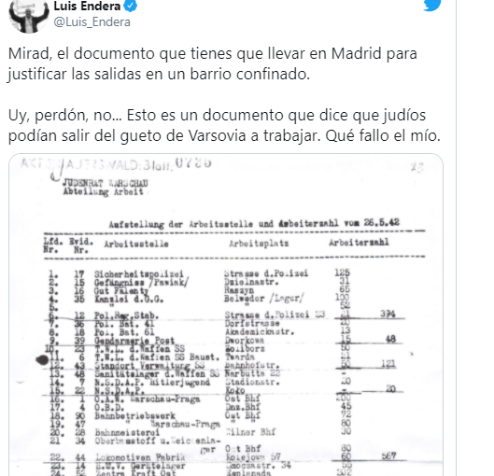
Holocaust trivialization in pandemic context (COVID-19)//Influencers
Some influencers opposed the general consensus on COVID-19 strategies and suggested alternative narratives that trivialized Holocaust memory.
"Look at the document you have to carry to get out of a confined neighbourhood. Or forgiveness, this is not a document that says which Jews can go out to work from the Warsaw Ghetto (…)” [Film director Luís Endera (25.5K followers) ]

Slide 11
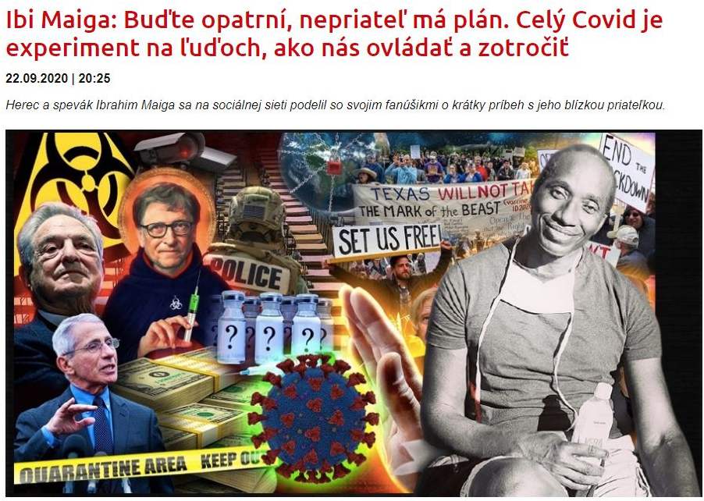
Holocaust trivialization in pandemic context (COVID-19)//Influencers
Some influencers opposed the general consensus on COVID-19 strategies and suggested alternative narratives that trivialized Holocaust memory.
”Be careful, the enemy has a plan. The whole COVID thing is an experiment on people – on how to control and enslave us” [Actor and singer Ibrahim Maiga, Slovakia ]

Slide 12
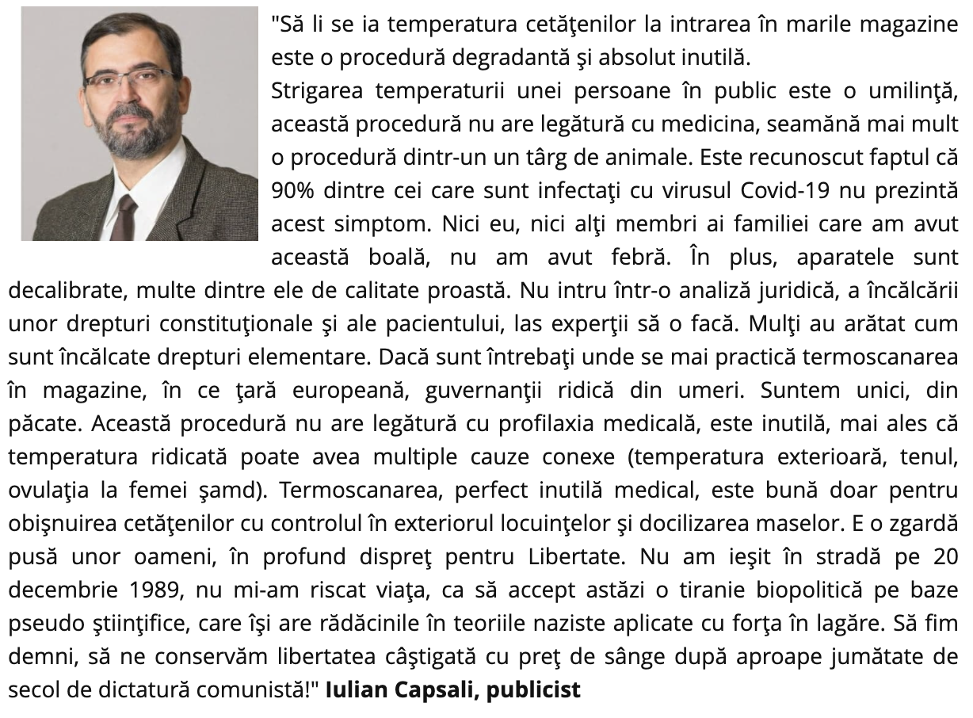
Holocaust trivialization in pandemic context (COVID-19)//Influencers
Some influencers opposed the general consensus on COVID-19 strategies and suggested alternative narratives that trivialized Holocaust memory.
” I did not risk my life to accept today a biopolitical tyranny on a pseudo-scientific basis, which has its roots in Nazi theories forcibly applied in camps. Let us be worthy, let us preserve the freedom we have earned with the price of blood after almost half a century of communist dictatorship! ” [Film director, writer Iulian Capsali, Romania ]

Slide 13
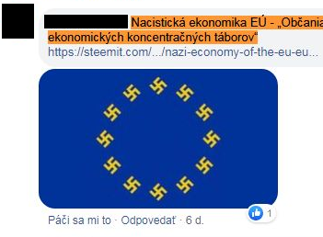
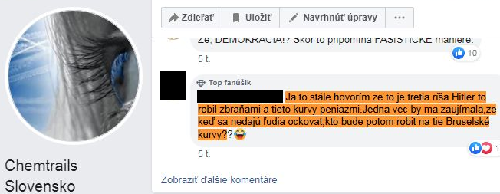
Holocaust trivialization in pandemic context (COVID-19)//Common users
As opposed to politicians that were more contained in comparing the medical crisis to the Holocaust drama, common users engaged in promoting more virulent narratives (conspiracy theories or critics to national Governments or other international organizations)
Translation: Nazi economy of the EU citizen of concentration camps
Translation: I keep saying that this is Hitler's third empire. Hitler did it with weapons and these whores with money. One thing would interest me. If people can't be vaccinated, then what will the Brussle whores do

Slide 14
Holocaust trivialization in pandemic context (COVID-19)//Common users
As opposed to politicians that were more contained in comparing the medical crisis to the Holocaust drama, common users engaged in promoting more virulent narratives (conspiracy theories or critics to national Governments or other international organizations)

Slide 15
Dirty politics with dirty arguments//Spain
For years in Spain institutional political confrontation tends to be hyperbolic, and very focused on the historical archetypes of the 1936 civil war.
Concepts "facha" -fascist- and social-communist Bolivarian in reference to Venezuela's Chavists regime, are widespread and therefore trivialized by misuse.
This systematic trivialization has been projected in public conversation into a banalization of the Holocaust in hyperbolic criticism of the management of different governments

Slide 16
Dirty politics with dirty arguments//Romania
Since 2014 when Romanians elected President Klaus Iohannis (Romanian with German ethnic background) his political opponents have been perpetrating offensive narrative that portray Iohannis as the Nazi icon in domestic politics
He is mostly labelled as a dictator and his actions are criticized for being inspired by the Nazi regime
Several high ranked politicians have been sanctioned for discriminatory and defamatory comments, yet with limited effect
During COVID-19 crisis, most of his contestants within the general public argued that Iohannis is implementing a systemic plan to eliminate them either for not complying to the imposed restrictions or for not adhering to his doctrine or political party.

Slide 17
Conclusions
Holocaust memory is tainted and abusively distorted by COVID-19 negationists and by politicians that speculated the context
The trivializing narratives oscillate from clear Anti-Semitic attitudes (ideologically motivated) to blunt ignorance that amplifies due to the existent moral panic

Slide 18
Questions and challenges
Have you met these narratives in your countries? Please share.
Is NOW the time for prompt and drastic counter actions to address/redress the phenomenon? Let’s talk.

