Slide 1
Policies and regulations beyond the European Union - in Russia and its sphere of legal influence INACH, Amsterdam, November 2022

Slide 3
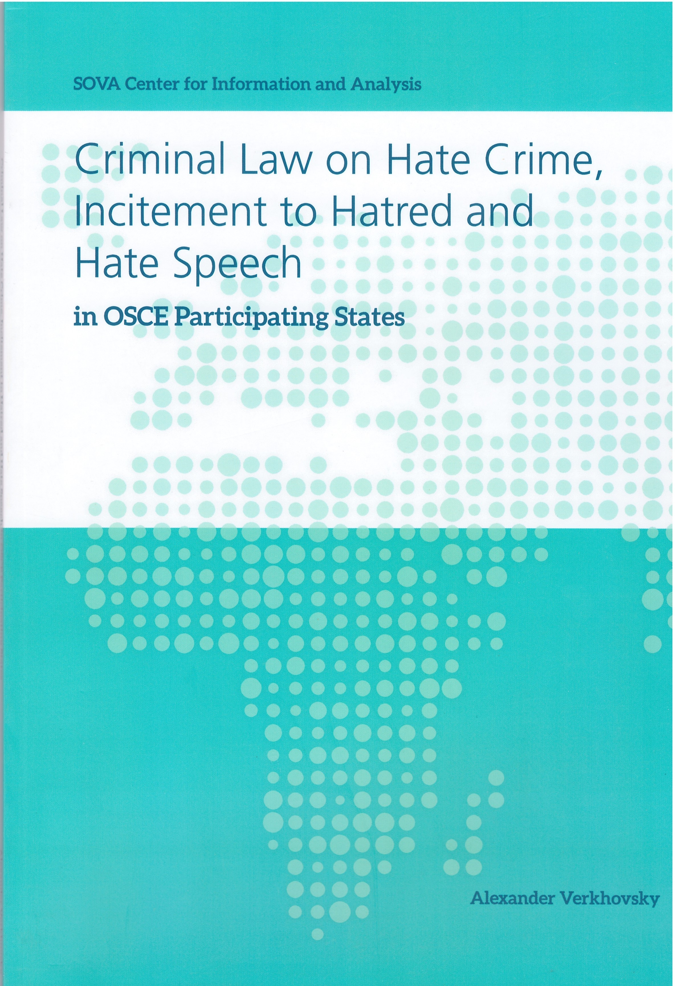

Slide 4
PACE Resolution 1344
“Threat posed to democracy by extremist parties and movements in Europe”
Extremism is defined here as
“a form of political activity that overtly or covertly rejects the principles of parliamentary democracy”.

Slide 7
Violent hate crimes and counteraction to them

Slide 8
What is wrong here:
Vague definition
Not related to violence at all
Too wide criminal norms
Open list of biases in the counter hate speech norm
New and new norms and updates

Slide 9
Criminal and administrtive prosecution for ‘extremist statements’

Slide 10
What else could we ban:
Some organizations
‘Extremist materials’
Any historical criticism – under anti-Nazi disguise
Anti-religious criticism or satire
Any suspicious symbols per se
Criticism on the war

Slide 11
Our way to cleanse Internet
From banned materials to blocked web-sites
From the judicial procedure to the extra-judicial one
Extended version of NetzDG + extended counter-censorship
‘Everything for friends – and the law for enemies’

Slide 12
Follow our news at sova-center.ru On December 30, 2016, the Ministry of Justice forcibly included the regional public organization SOVA Center on the list of “non-profit organizations performing the functions of a foreign agent.” We did not agree with this decision and appealed against it. On June 14, 2022, the European Court of Human Rights upheld the Center’s appeal and found the Ministry of Justice’s decision in violation of the European Convention on Human Rights.

